Slide 1

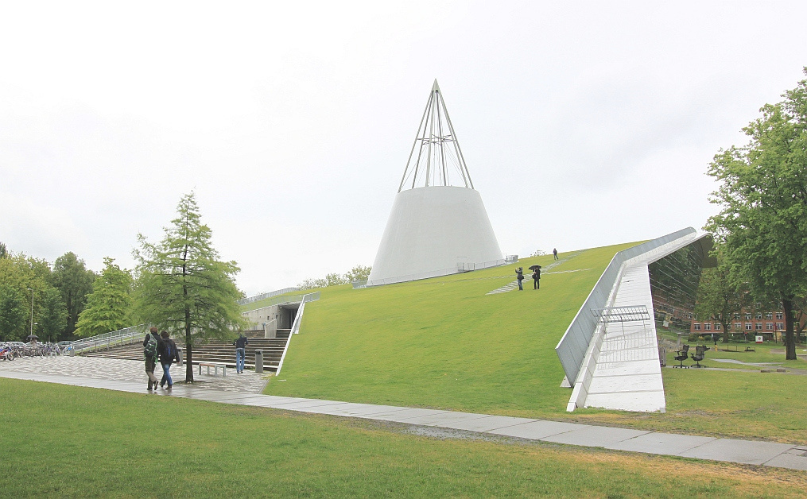



Title
Manuscript ID
Authors & Co-Authors
Affiliation
www. pfdm2025.com
15 minutes presentation & 5 minutes Q&A

Slide 2
INTRODUCTION
Paragraph...

Slide 3
METHODOLOGY
Paragraph...

Slide 4
RESULTS AND DISCUSSION
Paragraph...

Slide 5
CONCLUSION
Paragraph...

Slide 6
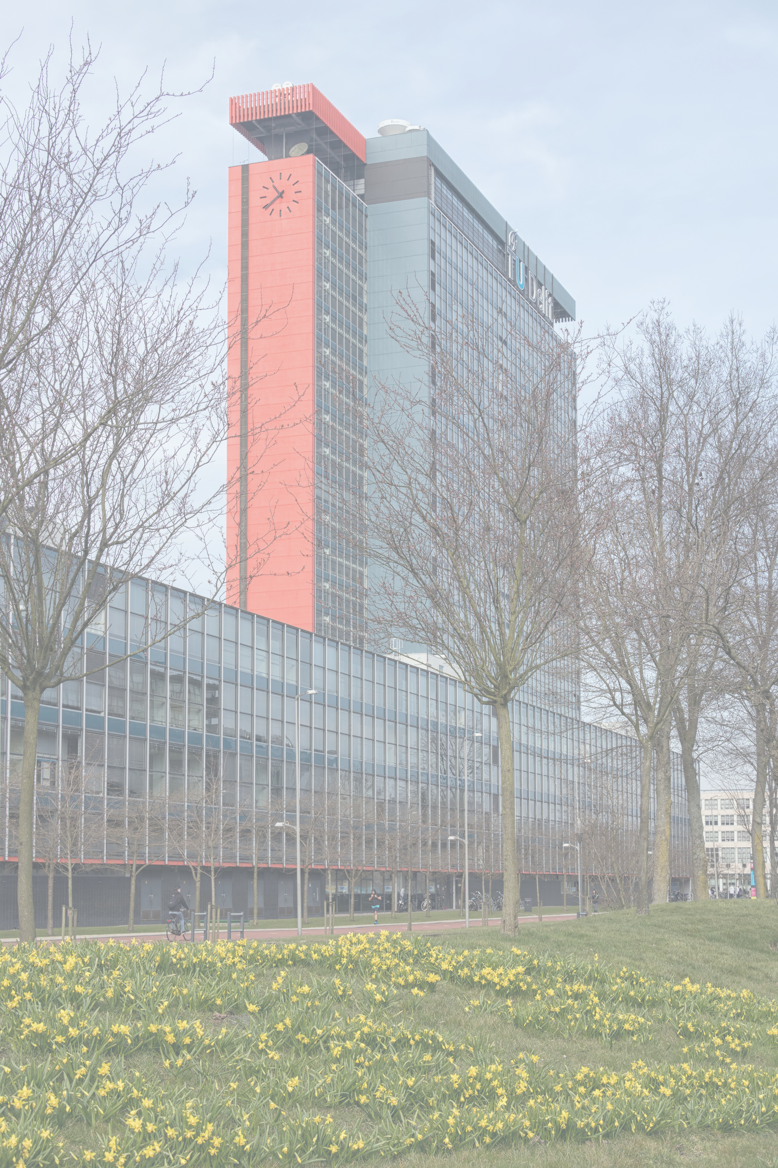
THANK
YOU

